Slide 1
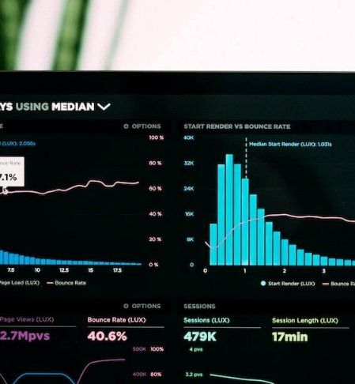
HUMAN RESOURCE ANALYTICS DASHBOARD FOR ALTERA
PREPARED AND PRESENTED BY: BAFFOE OBED OPPONG
COMPLETED ON : 10/07/2024

Slide 2
TABLE OF CONTENTS
INTRODUCTION
DATA PREPARATION
DASHBOARD FEATURES
KEY INSIGHTS
RECOMMENDATIONS
CONCLUSION

Slide 3


INTRODUCTION
Project Objective: Develop a Simple HR Analytics Dashboard for insightful workforce reporting.
Dashboard Scope: - Total Employees - Employment Type Breakdown - Employee Recruitment Channels - Employee Gender Distribution - Department Overview - Employee Geographic Location Distribution - Training Metrics - Awards and Recognition - Employee Age Distribution - Gender-Based Ratings and Experience - Employee Education Level - Performance Metrics - Employee Length of Service

Slide 4
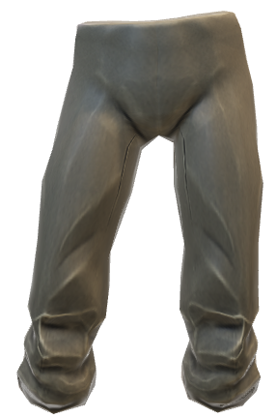

DATA PREPARATION
Data Source: Data received from Only Quality Data. Fields: EmpID, Department, Education, Gender, Recruitment Channel, FT/PT, Number_of_Trainings, Age, Previous_Year_Rating, Length_of_Service, KPIs_met>80%, Awards_Won, Avg_Training_Score.
Data Cleaning: Data loaded and transformed to Power Query. Data types checked and corrected. Missing values in Number_of_Trainings field replaced with mean values.
Data Preparation: Created 'AlteraMeasures' table. Measures: 'CurrentDate' and 'Total Employees'. Location field categorized and specified to Ghana.

Slide 5
DASHBOARD FEATURES
Overview: HR analytics dashboard for ALTERA providing insights on various HR metrics.
Visualizations: Card, bar chart, column chart, pie chart, doughnut chart and line graphs were used to find these insights:
- Total Employees - Employment Type Breakdown - Gender Distribution - Trainings by Department - Employee Recruitment Channel - Department Overview - Awards Won by Department - Employee Education Level - Average KPIs >80% met by Gender - Average Length of Service - Employee Age Distribution - Average Rating

Slide 6
KEY INSIGHTS
Total Employees: 234,907 as of 7/10/2024.
Employment Type Breakdown: Majority full-time (64.03%), significant part-time (35.97%).
Gender Distribution: Higher male representation (70.65%) compared to females (29.35%).
Trainings by Department: Focus on Sales & Marketing, Operations, Procurement; fewer in Legal, Research.
Employee Recruitment Channel: Indicate a reliance on digital platforms for attracting talent.
Department Overview: Sales & Marketing, Operations, and Technology are the largest departments, while Legal and Research have relatively smaller teams.

Slide 7
TRENDS AND IMPLICATIONS
Trends:
Gender Imbalance: Higher male representation.
Focus on Sales & Marketing and Operations: More trainings, larger teams.
Implications:
Need for diversity and inclusion initiatives. Training and development focus in underrepresented departments. Optimization of recruitment strategy for a diverse talent pool. Resource allocation based on department size and growth potential.

Slide 8
RECOMMENDATIONS
Strategies:
Gender Diversity Initiatives: Set diversity targets, mentorship programs.
Training and Development Programs: Focus on underrepresented departments.
Recruitment Strategy Enhancement: Explore additional channels, professional networks.
Resource Allocation Optimization: Allocate resources based on department growth potential.
Improvements:
Data Collection: Capture more granular information.
Data Analysis Techniques: Utilize predictive analytics and machine learning.

Slide 9
CONCLUSION
Summary: The HR analytics dashboard provides valuable insights into various HR metrics for ALTERA.
Future Work:
Employee Engagement Analysis: Explore factors influencing satisfaction.
Performance Analysis: Detailed assessment of KPIs and departmental performance.
Predictive Analytics: Forecast future workforce needs, talent gaps.
Enhanced Visualization: Improve usability and interactivity of the dashboard.
Conclusion

